Slide 1
Servlet

Slide 2
TOC
-Client and Server
- Tomcat installation
- Servlet Architecture
- LifeCycle of Servlet
- Servlet API
- HelloServlet
- HttpSession
- URL Rewriting
- Cookies
- Servlet Config and ServletContext
-Form Processing
-Request Dispatcher

Slide 3
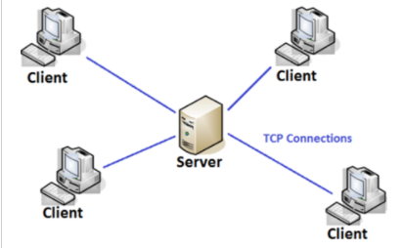
Client and Server Architecture
Client-server architecture is an architecture of a computer network in which many clients (remote processors) request and receive service from a centralized server (host computer).
Client computers provide an interface to allow a computer user to request services of the server and to display the results the server returns.
Servers wait for requests to arrive from clients and then respond to them.

Slide 4
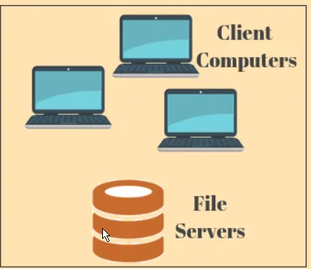
Tier 1
In the 1-tier architecture, all client/server configuration setting, user interface environment, data logic, and business logic are existed on the same system.
These types of services are reliable but it is very difficult tasks to handle because they contain all data in different variance, which are allotted the replication of entire work.

Slide 5
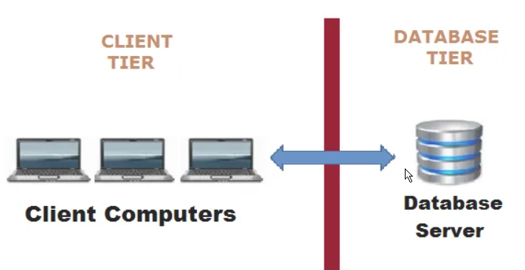
Tier 2
fat client thin server architecture:
If Business Logic & Data Logic collected at a client-side.
thin client fat server architecture :
If Business Logic & Data Logic handled on the server

Slide 6
3 Tier Architecture
The 3 tiers are named the presentation tier, application tier, and data tier.
The presentation tier is the front end layer and consists of the user interface.
The application tier contains the functional business logic which drives an application’s core capabilities.
The data tier consists of a database system and the data access layer.

Slide 7
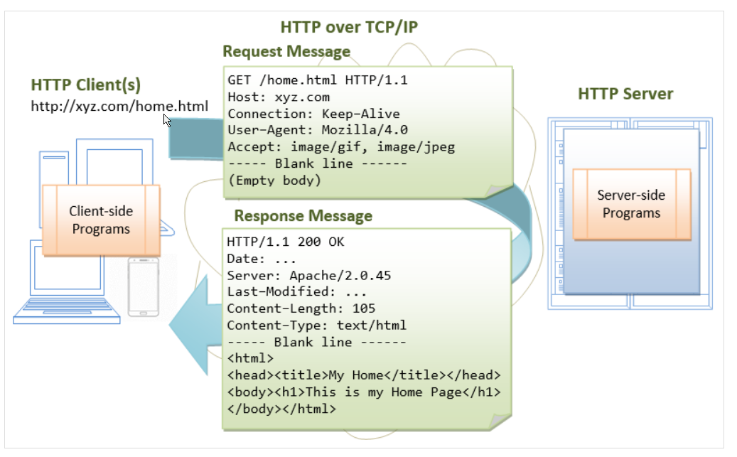
Http Protocol

Slide 8
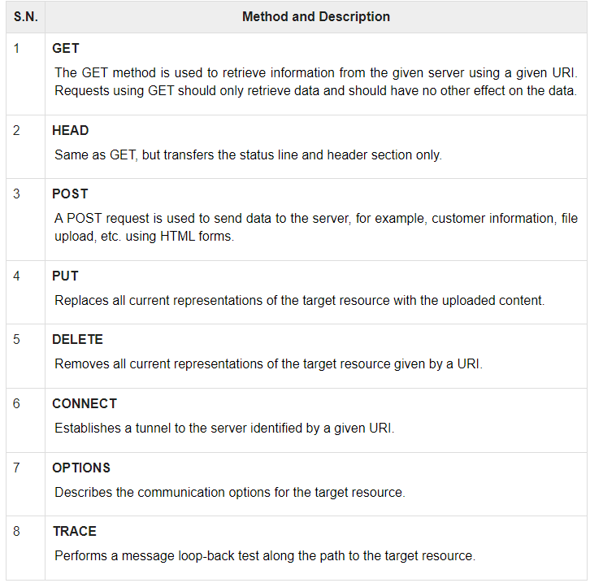
Common HTTP Methods

Slide 9
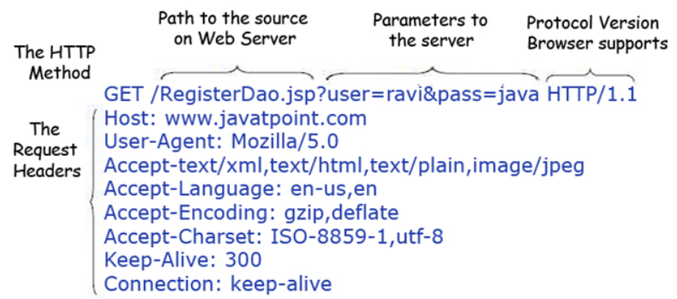
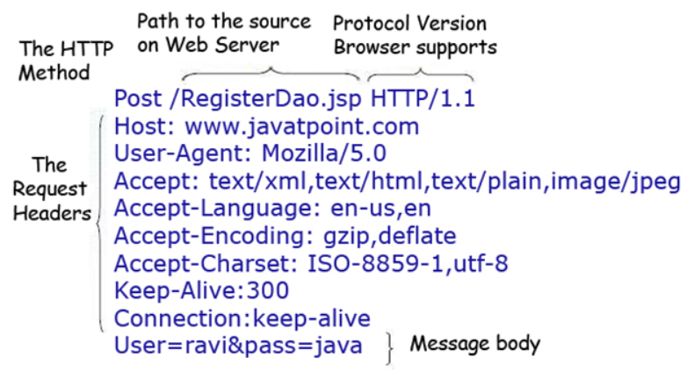
Get Vs Post
Limited amount to data can sent .
Not Secured
Unlimited amount to data can sent .
Secured

Slide 10
Setup Tomcat
https://tomcat.apache.org/download-80.cgi

Slide 11
Servlet
Servlet is a technology which is used to create a web application.
Servlet is an API that provides many interfaces and classes including documentation.
Servlet is an interface that must be implemented for creating any Servlet.
Servlet is a class that extends the capabilities of the servers and responds to the incoming requests. It can respond to any requests.
Servlet is a web component that is deployed on the server to create a dynamic web page.

Slide 12
Servlet API
javax.servlet - Not specific to protocol
Interface
Servlet
ServletRequest
ServletResponse
RequestDispatcher
ServletConfig
ServletContext
Class
GenericServlet
ServletInputStream
ServletOutputStream
ServletRequestWrapper
ServletResponseWrapper
ServletRequestEvent

Slide 13
Servlet API
javax.servlet.http - Specific to http protocol
Interfaces
HttpServletRequest
HttpServletResponse
HttpSession
HttpSessionListener
Class
HttpServlet
Cookie
HttpServletRequestWrapper
HttpServletResponseWrapper

Slide 14
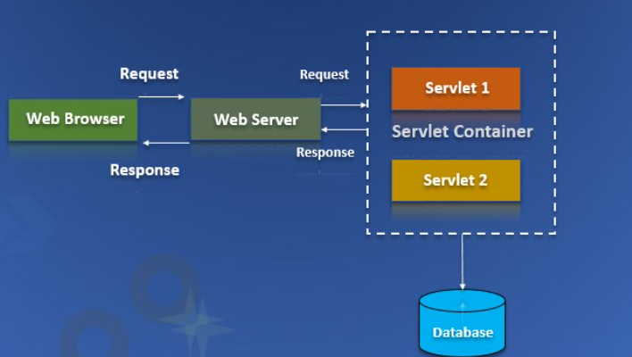
Servlet Architecture

Slide 15
Servlet LifeCycle
Load the Servlet Class
Create Servlet instance
Call init () -public void init(ServletConfig config) throws ServletException
Call Service() - public void service(ServletRequest request, ServletResponse response) throws ServletException, IOException
Call destroy() - public void destroy()
https://docs.oracle.com/javaee/6/api/javax/servlet/Servlet.html
https://docs.oracle.com/cd/E17802_01/products/products/servlet/2.1/api/javax.servlet.http.HttpServlet.html

Slide 16
How Web Container Works?
maps the request with the servlet in the web.xml file.
creates request and response objects for this request
calls the service method on the thread
The public service method internally calls the protected service method
The protected service method calls the doGet method depending on the type of request.
The doGet method generates the response and it is passed to the client.
After sending the response, the web container deletes the request and response objects. The thread is contained in the thread pool or deleted depends on the server implementation.

Slide 17
Ways to Create Servlet
By implementing the Servlet interface
By inheriting the GenericServlet class
By inheriting the HttpServlet class

Slide 18
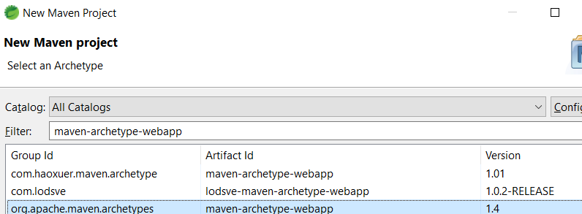
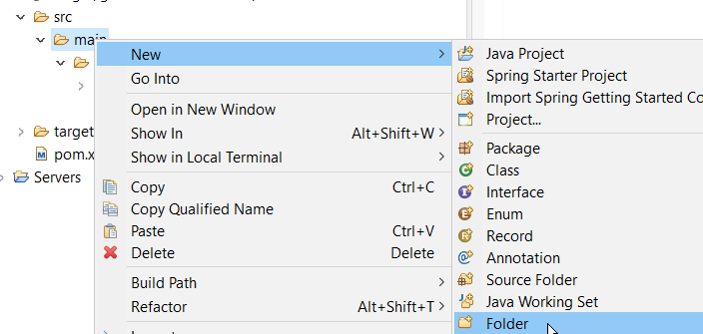
Hello Servlet
Refer –
Open Eclipse 2021-03
Create Dynamic Project
How to create a WAR file
D:\Revature-2021-May\JavaFullStack3.1\Week2_Day12345\Hello>jar -cvf hello.war *

Slide 19
Web.xml
<servlet>
<servlet-name>wish</servlet-name>
<servlet-class>com.test.HelloServlet</servlet-class>
</servlet>
<servlet-mapping>
<servlet-name>wish</servlet-name>
<url-pattern>/HelloServlet</url-pattern>
</servlet-mapping>

Slide 20
welcome-file-list
A welcome file is the file that is invoked automatically by the server, if you don't specify any file name.

Slide 21
<load-on-startup></load-on-startup>
pre initialization of servlet.
WHY?
servlet will be loaded at project deployment time or server start. -> Take less time to respond.
Positive value
0 - The 0 value will be loaded first then 1, 2, 3
Negative Value
servlet will be loaded at request time, at first request.

Slide 22
ServletRequest
public String getParameter(String name)
public String[] getParameterValues(String name)
public int getContentLength()

Slide 23
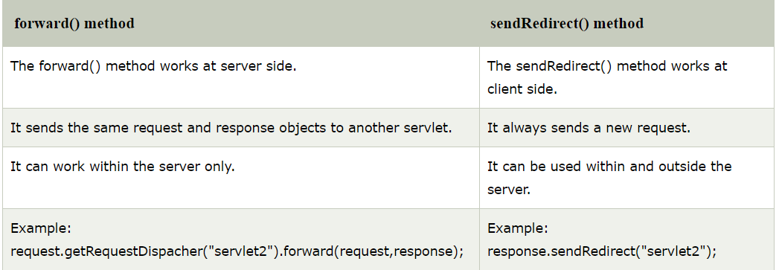
Servlet Collaboration
RequestDispatcher
sendRedirect

Slide 24
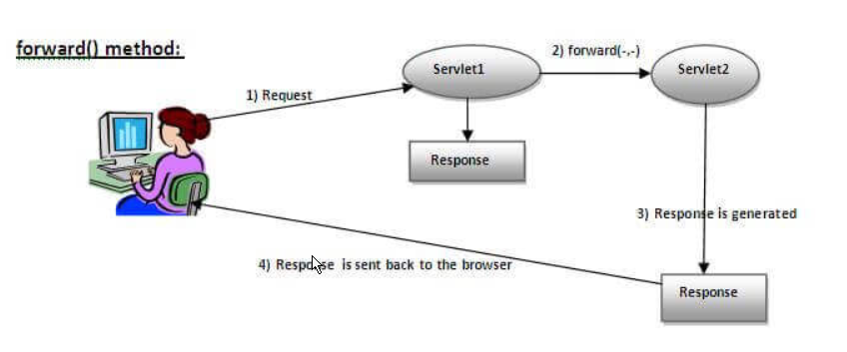
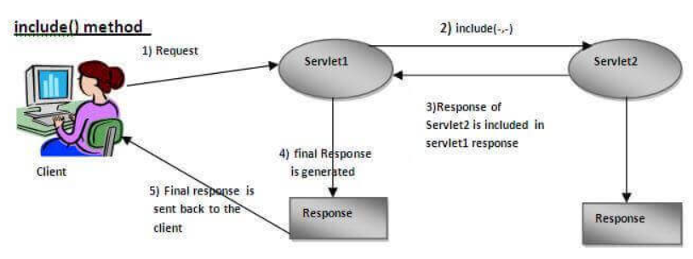
Servlet Collaboration
RequestDispatcher interface
public void forward(ServletRequest request, ServletResponse response ) throws ServletException, java.io.IOException
public void include(ServletRequest request,ServletResponse response)throws ServletException,java.io.IOException:Includes

Slide 25
Forward() and SendRedirect()
Forward()
The forward() method works at server side.
It sends the same request and response objects to another servlet.
It can work within the server only.
sendRedirect()
The sendRedirect() method works at client side.
It always sends a new request.
It can be used within and outside the server.

Slide 26
ServletConfig vs ServletContext
ServletConfig
ServletConfig object is one per servlet class
destroyed once the servlet execution is completed.
Object of ServletConfig will be created during initialization process of the servlet
ServletContext
ServletContext object is global to entire web application
Object of ServletContext will be created at the time of web application deployment
ServletContext object will be available even before giving the first request

Slide 27
Session Management
Session Tracking is a way to maintain state (data) of an user. It is also known as session management in servlet.
Http protocol is a stateless so we need to maintain state using session tracking techniques. Each time user requests to the server, server treats the request as the new request. So we need to maintain the state of an user to recognize to particular user.
HTTP is stateless that means each request is considered as the new request

Slide 28
Why Session?
To recognize the user

Slide 29
Session Tracking Techniques
Cookies
Hidden Form Field
URL Rewriting
HttpSession

Slide 30
Cookie in Servlet
A cookie is a small piece of information that is persisted between the multiple client requests.
A cookie has a name, a single value, and optional attributes such as a comment, path and domain qualifiers, a maximum age, and a version number.

Slide 31
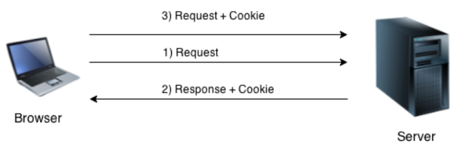
How cookie works?
By default, each request is considered as a new request. In cookies technique, we add cookie with response from the servlet. So cookie is stored in the cache of the browser. After that if request is sent by the user, cookie is added with request by default.

Slide 32
javax.servlet.http.Cookie
public void addCookie(Cookie ck):method of HttpServletResponse interface is used to add cookie in response object.
public Cookie[] getCookies():method of HttpServletRequest interface is used to return all the cookies from the browser.

Slide 33
Cookie
Advantage
Simplest technique of maintaining the state.
Cookies are maintained at client side.
Disadvantage
It will not work if cookie is disabled from the browser.
Only textual information can be set in Cookie object.

Slide 34
Hidden Form field
Why?
used for maintaining the state of an user.
Use case:
To store page id or page name in the hidden field so that each page can be uniquely identified.

Slide 35
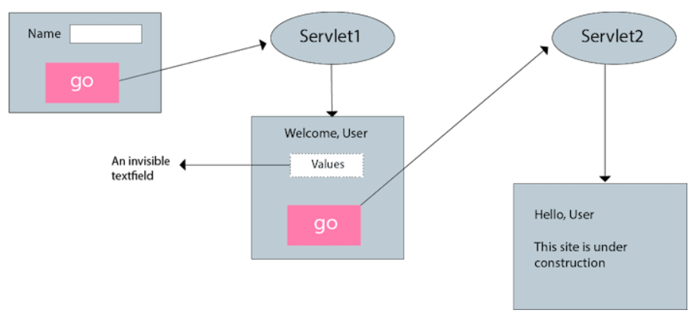
How it better than cookie
Advantages:
Cookie can be disabled but not field.
Disadvantages:
Maintained at server side
Extra information submission is required

Slide 36
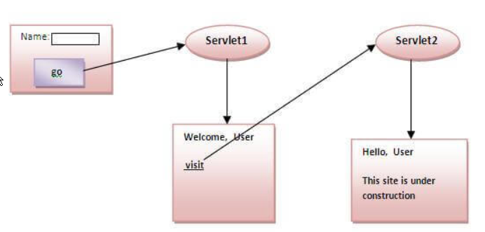
URL writing
In URL rewriting, we append a token or identifier to the URL of the next Servlet or the next resource.
Advantage of URL Rewriting
It will always work whether cookie is disabled or not (browser independent).
Extra form submission is not required on each pages.
Disadvantage of URL Rewriting
It will work only with links.
It can send Only textual information.

Slide 37
HttpSession
The container uses this id to identify the particular user.An object of HttpSession can be used to perform two tasks:
bind objects
view information about a session, such as the session identifier, creation time, and last accessed time.

Slide 38
How to create a Session object?
public HttpSession getSession():Returns the current session associated with this request, or if the request does not have a session, creates one.
public HttpSession getSession(boolean create):Returns the current HttpSession associated with this request or, if there is no current session and create is true, returns a new session.
public String getId():Returns a string containing the unique identifier value.
public long getCreationTime():Returns the time when this session was created, measured in milliseconds since midnight January 1, 1970 GMT.
public long getLastAccessedTime():Returns the last time the client sent a request associated with this session, as the number of milliseconds since midnight January 1, 1970 GMT.
public void invalidate():Invalidates this session then unbinds any objects bound to it.

Slide 39
Exception Handling
The deployment descriptor file just needs to be configured to handle the exceptions/errors thrown by a servlet.
The <error-page> element used to specify the invocation of servlets in response to certain exceptions or HTTP status codes. The following elements are used within an <error-page> element to handle error or exception:
<error-code> - used to specify a valid HTTP error code. For example, 404, 403, 500, etc.
<exception-type> - used to specify a fully-qualified class name of a Java exception type. For example, javax.servlet.ServletException,java.io.IOException, java.lang.RuntimeException, etc.
<location> - used to specify the location of the resource which is displayed to the user in case of an error. This might be a servlet, an HTML page, a JSP page, or something else

Slide 40
Request Attributes for Errors/Exceptions:
javax.servlet.error.status_code
javax.servlet.error.servlet_name
javax.servlet.error.exception
javax.servlet.error.request_uri
javax.servlet.error.exception_type
javax.servlet.error.message

Slide 41
MVC Design Pattern
Model
Model used to represent the business layer of the application.
No UI or presentation.
View
The view presents the model’s data to the user.
The view is a presentation layer that represents the user interface.
It displays the data fetched from the model layer by the controller and presents the data to the user whenever requests.
Controller
A controller is an intermediary between the model & a view.
It receives the user requests from the view layer and processes them.

Slide 42
Why MVC?

Slide 43
Jackson Library
Jackson is a very popular and efficient java based library to serialize or map java objects to JSON and vice versa.
Jackson has been known as "the Java JSON library“.
https://attacomsian.com/blog/jackson-write-json-file

